Slide 1
Single-trial classification of EEG in a visual object task
Using ICA and machine learning
Liz Mills, Justin Faber, Steven Emmel, Sydney Feldman
Feb 16, 2021
Stewart, Nuthmann, Sanguinetti, J Neuro Meth, 228 (2014) 1-14

Slide 2
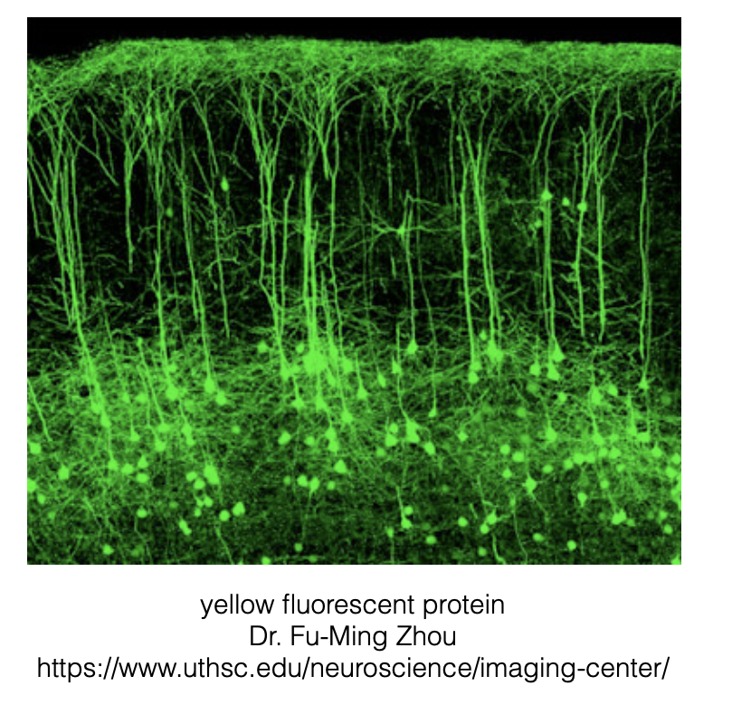
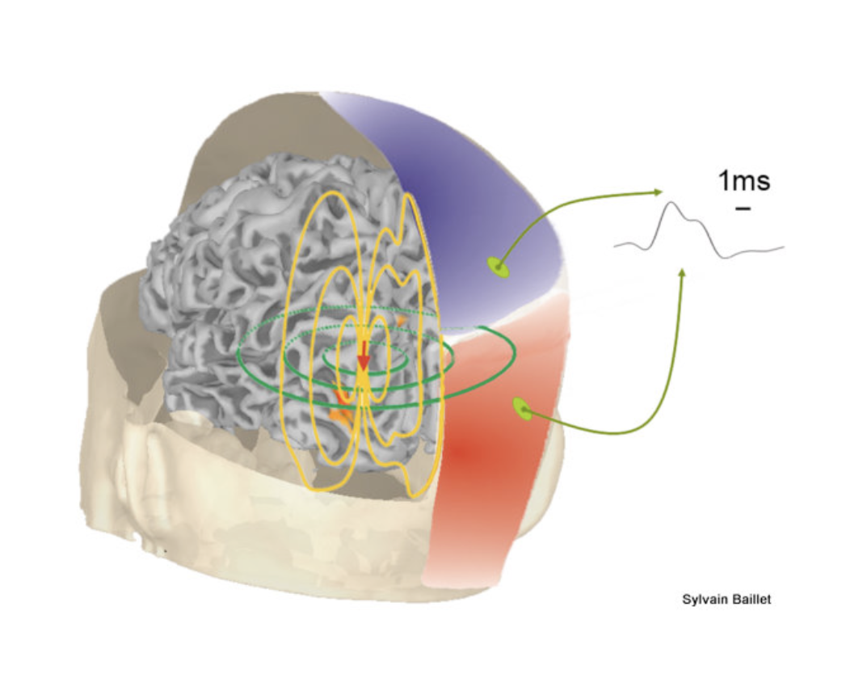

Slide 3
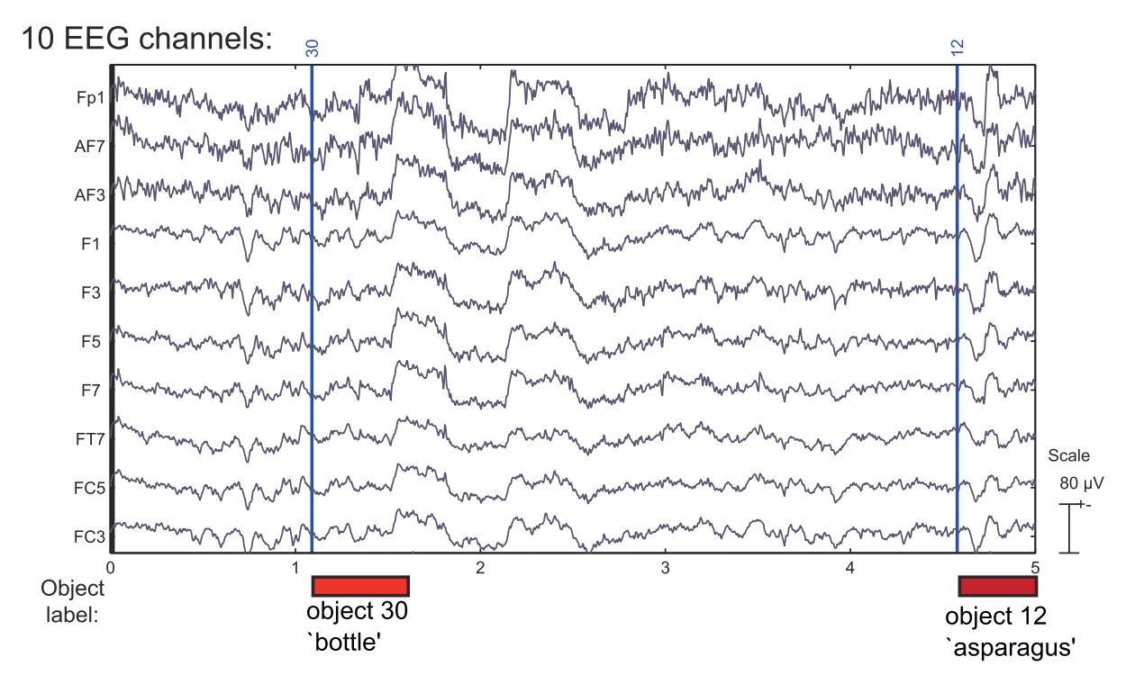
Single time trace of voltage signal at particular surface scalp locations
Different stim presented in a sequence
Continuous brain signal can be broken up into “trials,” all starting at t=0 of stim presented
We can focus analysis on particular “channel” location that has largest SNR for a given brain phenomenon we care about
Visual task uses neurons in back of the brain (occipital cortex)

Slide 4
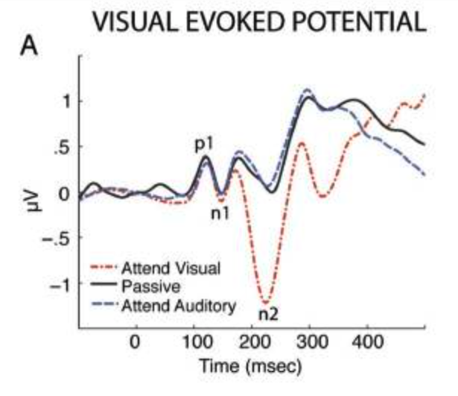
If we AVERAGE many trials, we can reduce increase SNR
But only capture truly time-locked signal
Different tasks can have different time-locked brain response
But averaging can remove some real signal (consider averaging time-points of ocean waves)
NO WAVES (unless perfectly time-locked)
Lenartowicz et al. J Cog Neuro (2014)

Slide 5
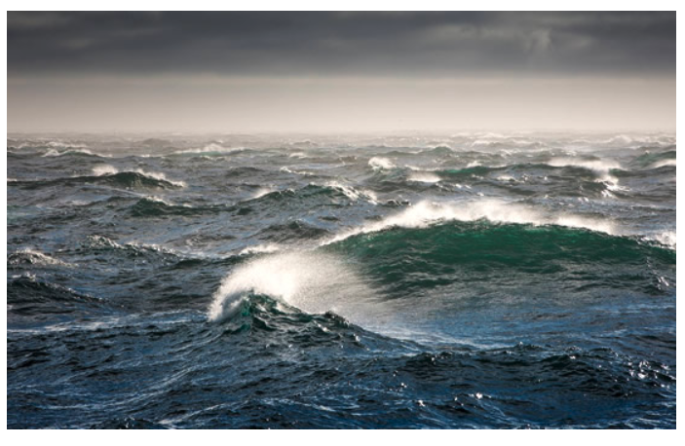
Averaging removes any signal that is NOT perfectly time-locked to trial start
If we AVERAGE many trials, we can reduce increase SNR
But only capture truly time-locked signal
Different tasks can have different time-locked brain response
But averaging can remove some real signal (consider averaging time-points of ocean waves)
NO WAVES (unless perfectly time-locked)
http://passyworldofmathematics.com/mathematics-of-ocean-waves-and-surfing/

Slide 6
If we AVERAGE many trials, we can reduce increase SNR
But only capture truly time-locked signal
Different tasks can have different time-locked brain response
But averaging can remove some real signal (consider averaging time-points of ocean waves)
NO WAVES (unless perfectly time-locked)
Lenartowicz et al. J Cog Neuro (2014)

Slide 7
Measure brain signal voltages and analyze INDIVIDUAL TRIALS for common signal
Break signal up into many trials
KEEP each trial separate, as an independent measurement
Use Machine Learning (SVM) to categorize signatures that are common across different trials of the same type.
BOTTLE and ASPARAGUS are both OBJECT VISUAL stim

Slide 8
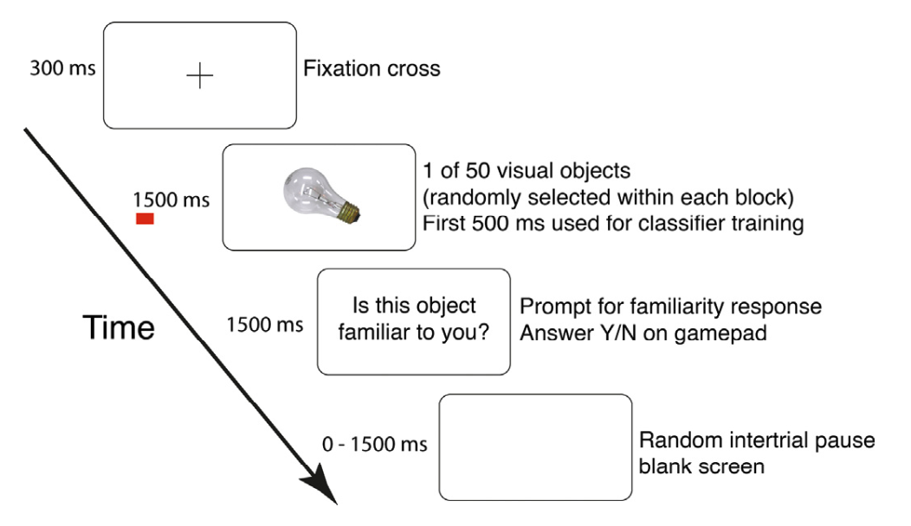
Measure brain signal voltages and analyze INDIVIDUAL TRIALS for common signal
Notes:
Liz slide?

Slide 9
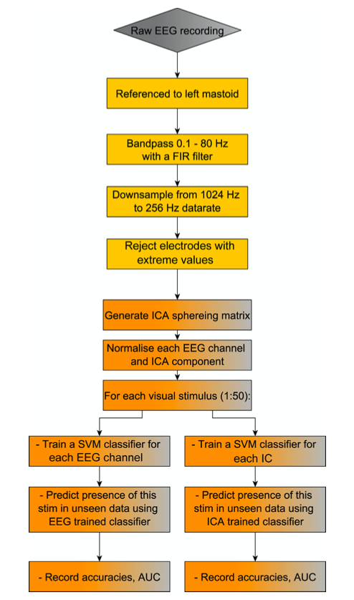
Notes:
Liz slide?

Slide 10
Notes:
Liz slide?

Slide 11
EEG Channels During Visual Stimulus
Why do the recordings look so correlated?
What do they do with all of this redundant information?

Slide 12
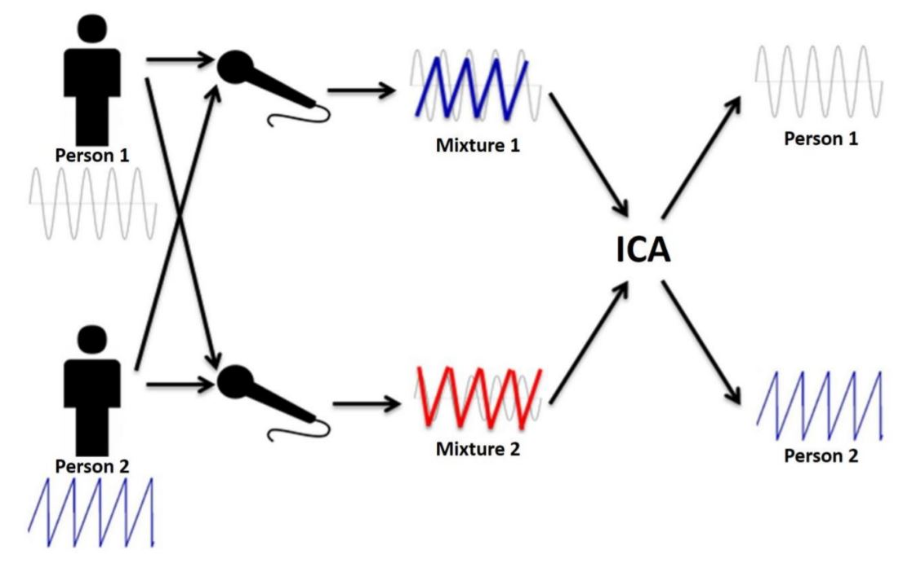
Independent Component Analysis (ICA) and The Cocktail Party Problem
D. Lubo-Robles et al. 2018

Slide 13
Independent Component Analysis (ICA) and The Cocktail Party Problem
In this case:
person 1, 2 = independent brain
processes
mixtures 1, 2 = EEGs

Slide 14
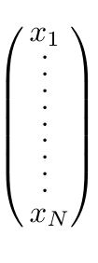
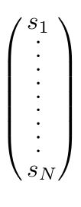
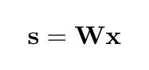
Independent Component Analysis (ICA)
Feature space of the observed data (EEGs)
Unmixing Matrix (W)
Feature space of the independent sources (brain processes)
Assumes all source features in s are independent.
Requires at least as many microphones as talkers: len(x) >= len(s)

Slide 15
Independent Component Analysis (ICA)
Feature space of the observed data (EEGs)
Unmixing Matrix (W)
Feature space of the independent sources (brain processes)
The Infomax algorithm is used to compute the independent sources.
W is determined by minimizing the mutual information between components in s.
This makes the new features as “independent” as possible.
ICA does not identify the number of sources or their amplitudes.

Slide 16
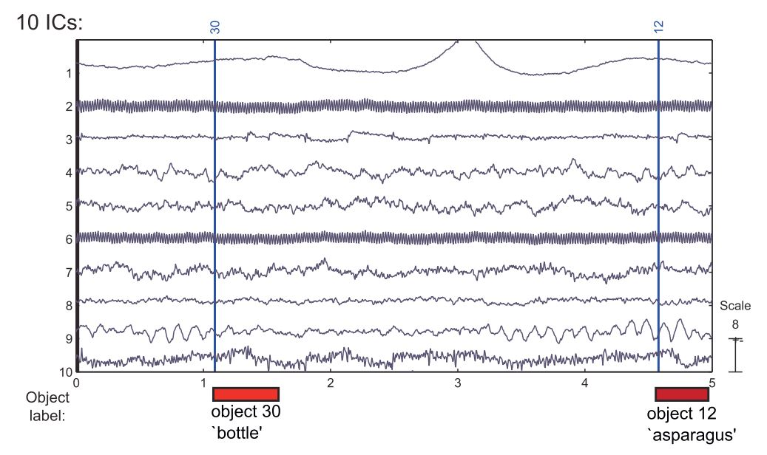
Before and After Independent Component Analysis (ICA)
Some of the independent components (IC) may be isolated measurements of the brain activity of interest.
Other ICs may just be “noise” from other electrical activity in the brain/heart/muscles, not relevant to the experiment. [and 60Hz line noise from electronics!]

Slide 17
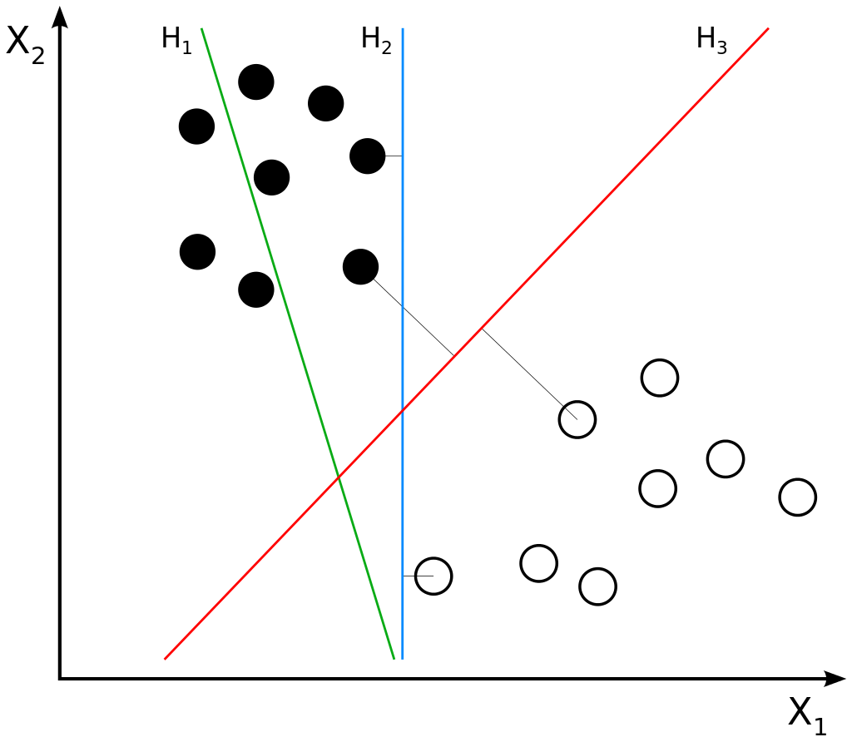
Support-Vector Machine (SVM)
• Supervised learning for classification and regression
• Non-probabilistic, linear, binary classifier (in most basic form)
• Finds p-1 dimensional hyperplane which divides N points with p features according to their classifications

Slide 18
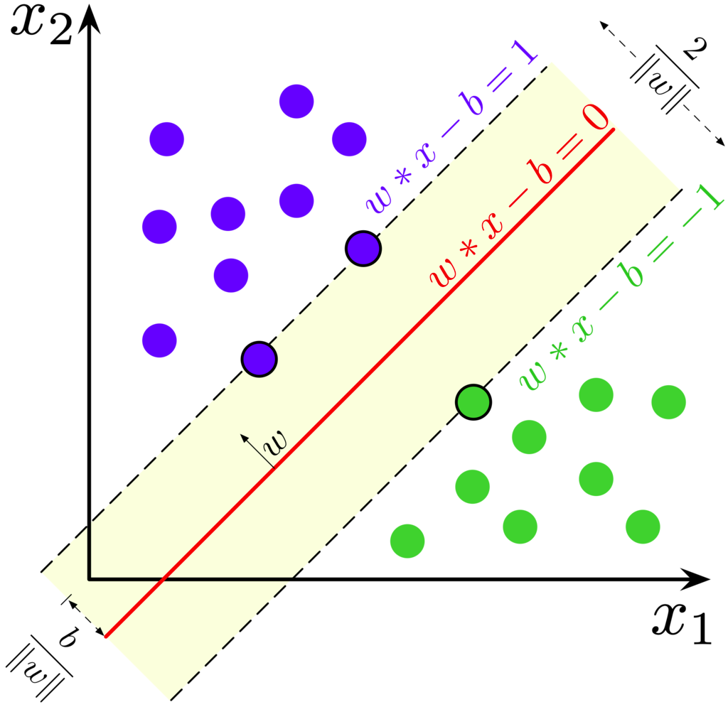
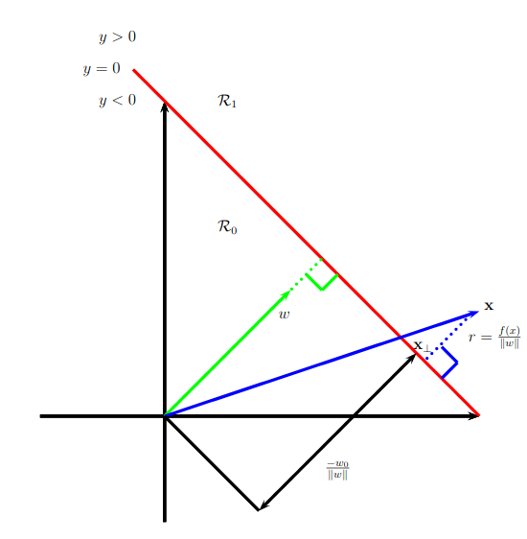
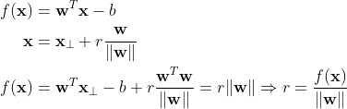
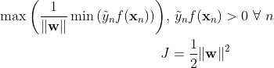
SVM Hard Margin Cost Function

Slide 19
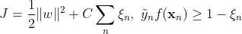
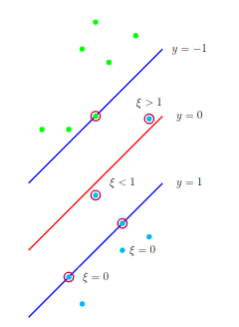
SVM Soft Margin Cost Function
• No longer require every point to lie on the correct side of the decision boundary
• The value of ξ corresponds to how extremely the boundary is violated
• C is a parameter which must be fixed somehow

Slide 20
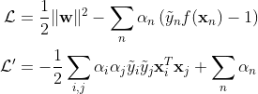
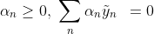
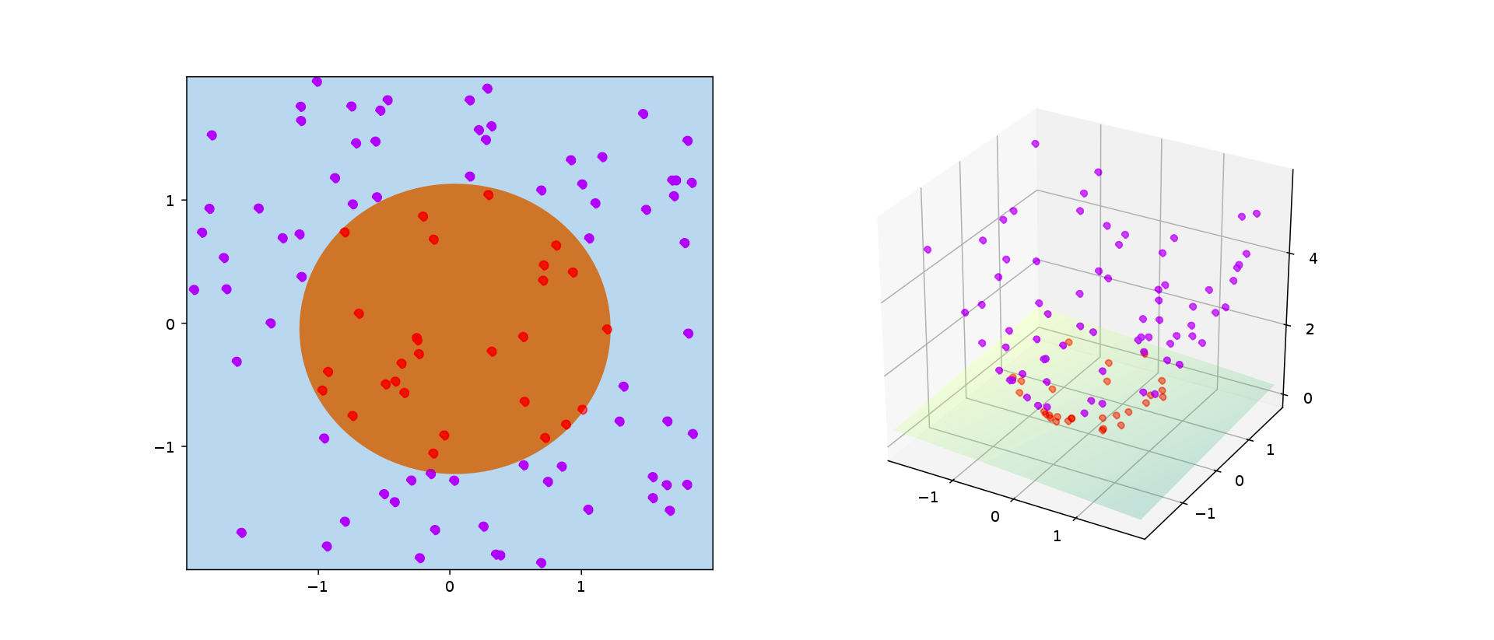
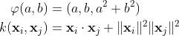
Dual Problem and Kernel Trick
Minimize wrt w,b and maximize wrt α
After setting partial derivatives wrt w, b equal to
zero

Slide 21
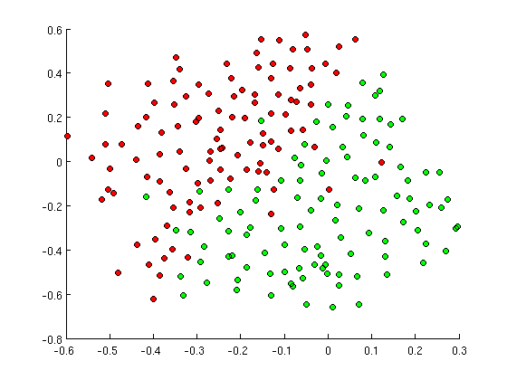

Radial Basis Function
• Acts as a similarity measure
• Used in a wide variety of applications
• Introduces new parameter γ

Slide 22
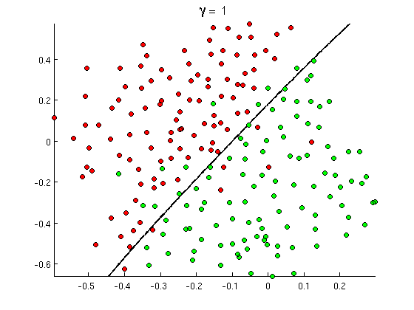
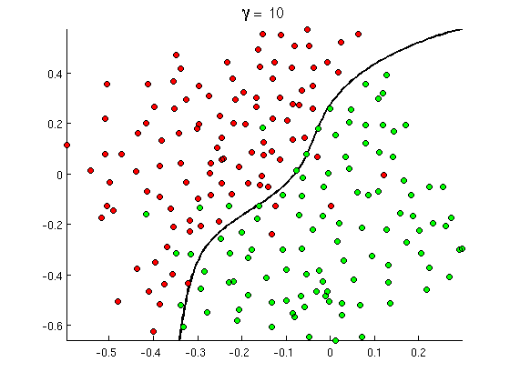
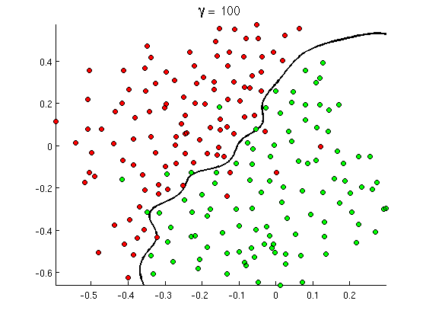
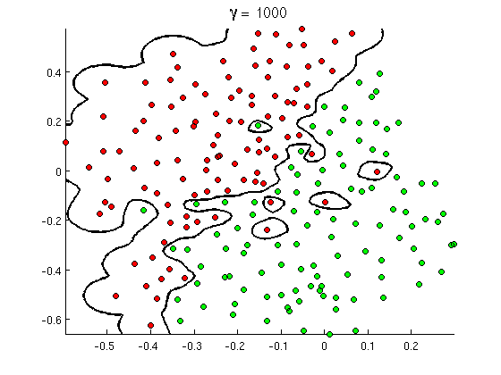
Radial Basis Function

Slide 23
Application of SVMs to EEG Data
EEG Data
SVM
Prediction
ICA
• Divide data into 50 one vs all classifiers
• Use libSVM gridsearch to set C and γ
• Apply RBF kernel
• Find values of α which maximize dual Lagrangian

Slide 24
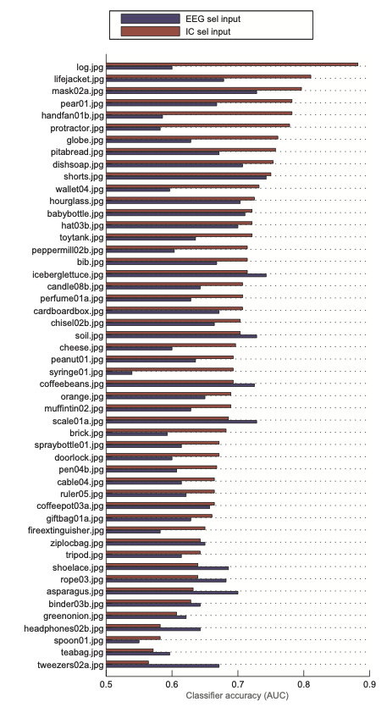
Conclusions
- able to correctly classify object present/object absent scenarios with 87% accuracy
- IC performed better than individual EEG channels

Slide 25
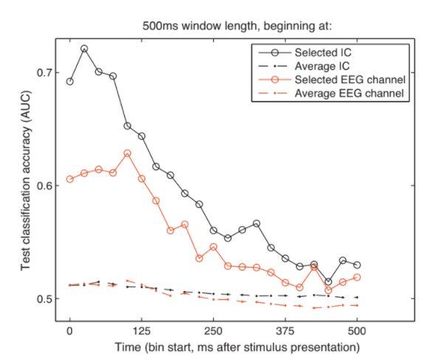
Conclusions
- single selected
channel inputs were better for classifying data than using all of the EEG signals/all of the ICs
Notes:
This is due to overfitting when “too much” data is present -- does not generalize well from training to testing sets
ICs separate into signal/noise/unrelated signal
Shows that single channel EEG data can be used for consistent high accuracy classification

Slide 26
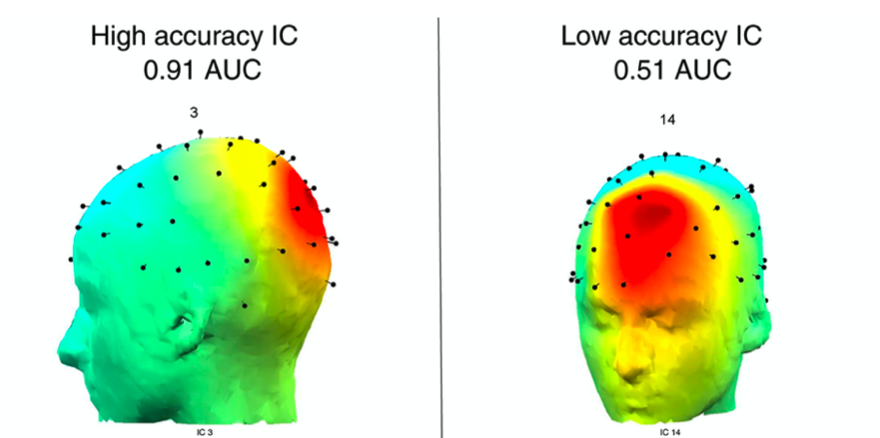

Slide 27
Additional Slides

Slide 28
